Slide 1

Tangerines
By Team Tangerine

Slide 2
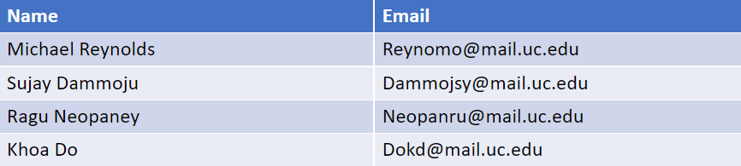
Contact Information
Team Members:
Advisor:

Slide 3
Goal & Background
Background:
Tangerines is a game with a mix of functionalities between Minesweeper and Picture Cross where red tangerines are given for each row and column. The goal of the game is to uncover all of the number 2 or 3 tiles without hitting a red tangerine to move on to the next level.
Goal Statements:
Learn about various aspects of web development
Develop a user-friendly application that is easy to navigate
Create a fully functional game that meets all standards of the game

Slide 4

Intellectual Merit
The project has tested our capabilities to create a functional cloud based game
We explored many ways to design how the game works and determine what would be user-friendly

Slide 5

Broader Impact
Can encourage others to create web based games
It provides a form of entertainment while playing our game

Slide 6
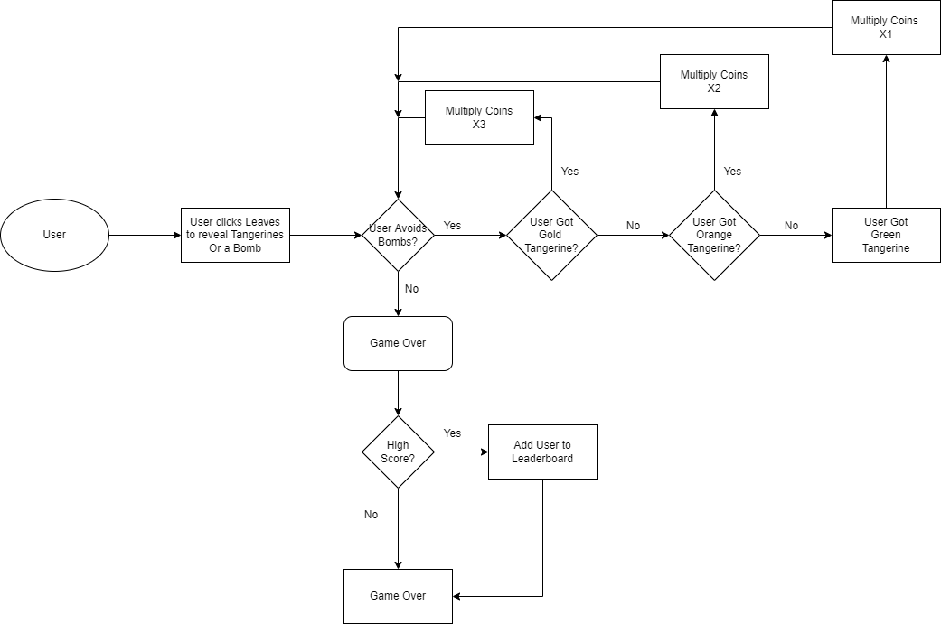
Design Specifications
A combination of HTML, CSS, and JavaScript was used to create this game
A user will click on all the leaves that does not contain a red tangerine in order to advance through a level
If a user clicks on a red tangerine, the level resets

Slide 7
Technologies
Technologies Used:
JavaScript - To create the functionality of the game
Cshtml- To create the User Interface of the game
DotNet6.0 - Controller to serve the pages required
EntityFramework core - to store and get data from database
Azure - To host the game online for anyone to play as well as host a global leaderboard

Slide 8
Milestones
Game designed and specified. | 10/2/2022 | 11/26/2022
Initial Game functionality. | 11/27/2022 | 1/28/2023
Refined game functionality | 1/29/2023 | 4/1/2023
Implementing leaderboard and Game Testing | 1/29/2023 | 4/22/2023

Slide 9
Results
We have created the layout for the game
We still need to add functionality to it as the layout is static right now
We are currently programming the features of the game
We have started working on the actual mechanics of how a level is played
The plan is to have the game finished on March 8th 2023.

Slide 10
Challenges
Time constraints
We worked through this challenge by planning accordingly to have certain tasks done by a date.
Determining which languages to use when creating our game
We researched web development ideas for creating a game
We assigned tasks to team members that are comfortable using web development languages

